Slide 1
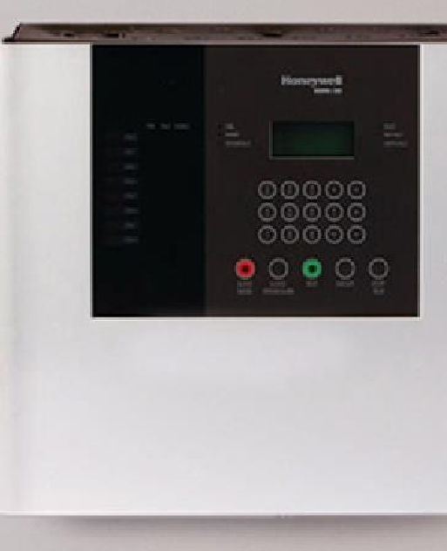
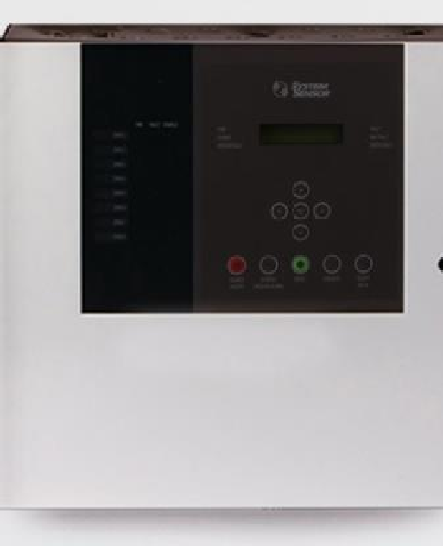
MASS MID
FIRE ALARM CONTROL PANELS
August 11, 2023

Slide 2
Current Range
CONTENT
New Morley Lite & System Sensor Conv.
Hardware Configuration Key Features & Benefits

Slide 3
MORLEY
MASS MID
LITE
&
FIRE ALARM
CONTROL
PANELS
SYSTEM
SENSOR

Slide 4
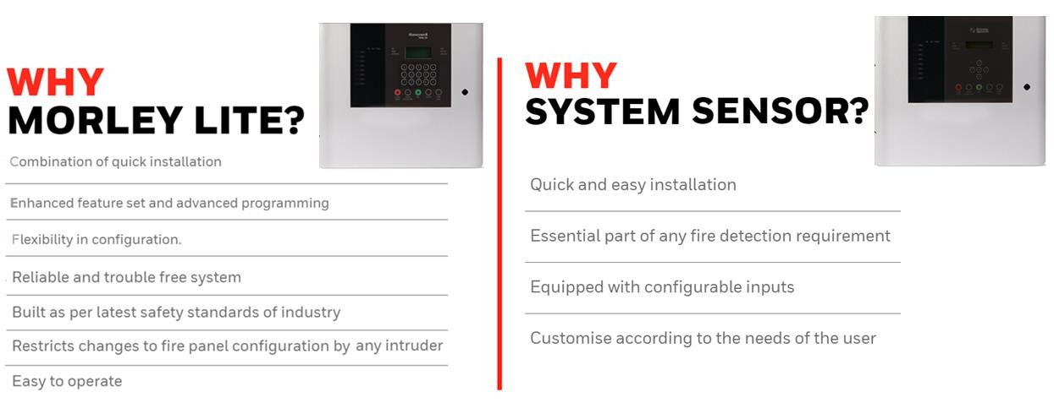
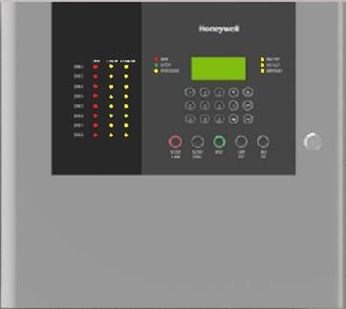
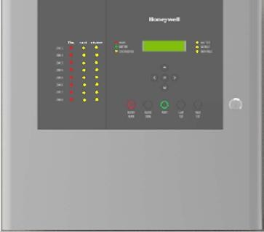
WHY MASS MID FIRE ALARM CONTROL PANELS
3

Slide 5
OFFERING COMPARISON
Features | System Sensor FACP | Morley-Lite FACP
Total FACP Capacity | 160 det+40MCP+10NA | 160 det+40MCP+10NA
Zone/Loop capacity | 20 det+5MCP+5NA | 20 det+5MCP+5NA
Certification | CE | CE
Addressability | X | Detectors (Photo/Heat/Multi)
N/w capability | Cloud Connectivity | Cloud Connectivity
3rd party Integration | Onboard relay | Onboard relay
Display | 16*2 Char LCD Display | 16*4 Char LCD Display
Event Log / Printing | 1000 | 1000
NAC / Loop powered | NAC | NAC
4

Slide 6
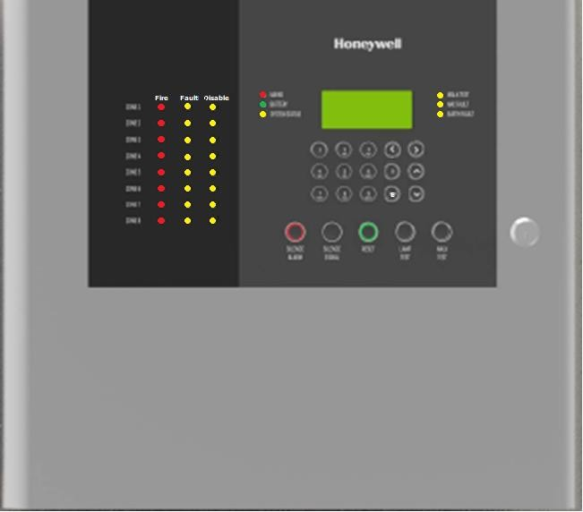
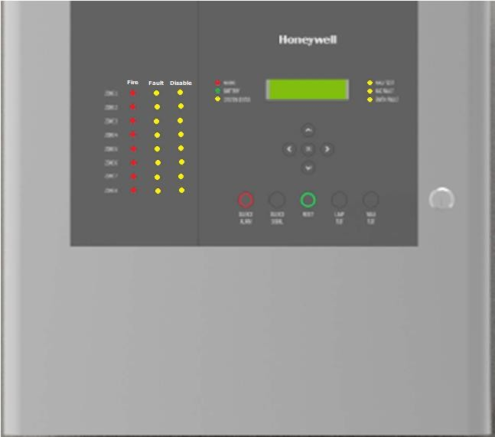
MORLEY LITE
Features / Benefits
16 X 4 LCD display, aesthetically designed front facia
Detector Addressability
2, 4, 6 and 8 Class B circuit – up to 1km : 20 detectors + 5 MCP
Fire, Fault, Configurable Relay + Staged Delay configuration for alarm verification
Class B circuit Wise NAC configuration + Enable/Disable facility
Battery Charging/Battery Internal Resistance Monitoring
Event Logging – 1000#
On board memory lock switch - prevents unauthorized panel configuration
Certified for Safety standard IEC 62368-1:2018; CE certificate.
Mechanical Keylock
Addressable
SYSTEM SENSOR
Features / Benefits
16 X 2 LCD display, aesthetically designed front facia/ L ED’s
2, 4, 6 and 8 zone variants
Fire, Fault, Configurable Relay
Individual Zone Isolation
Earth Fault Monitoring
Customizable text inserts
Certified for Safety standard IE C 62368-1:2018; CE certificate
Input for remote reset/evacuate/alert/fire
Mechanical Keylock
Conventional
5
5

Slide 7
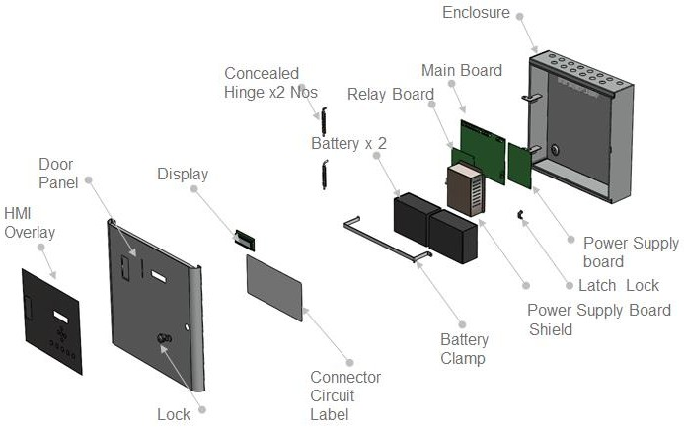
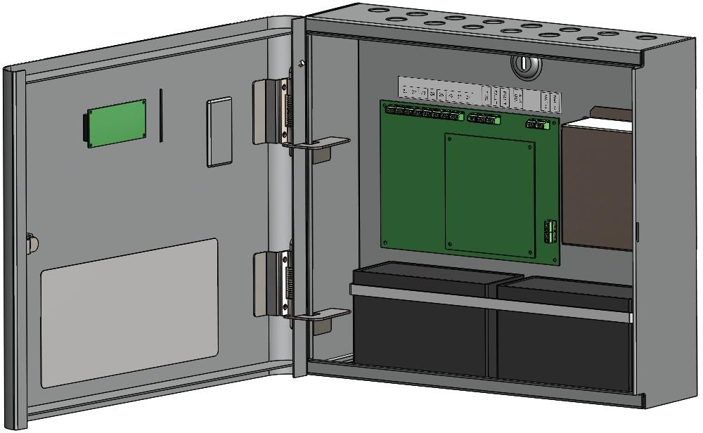
MORLEY LITE / SYSTEM SENSOR
Construction
Key Points
1. Powder coated metal enclosure; 2. Concealed Hinge,120 ⁰ opening
4. Connector tags on Mounting Bracket 5. 16x4 / 16x2 LCD Display Option
3. Metal Strap Battery clamp
6
6

Slide 8
APPLICATION AREAS
7

Slide 9
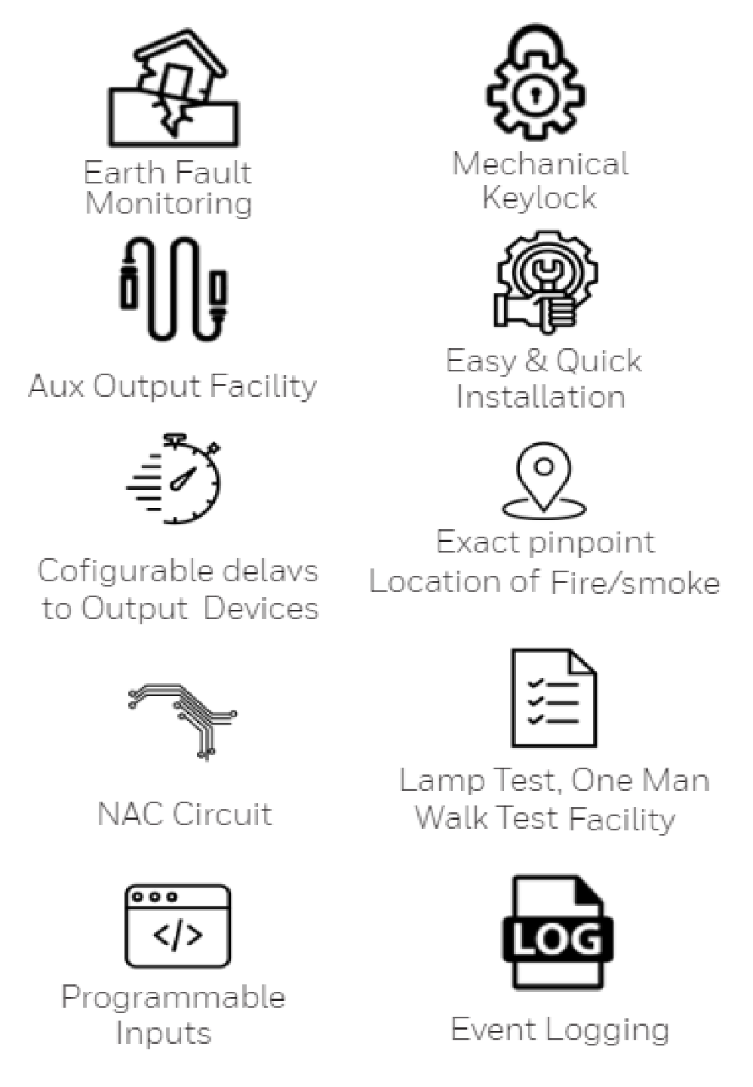
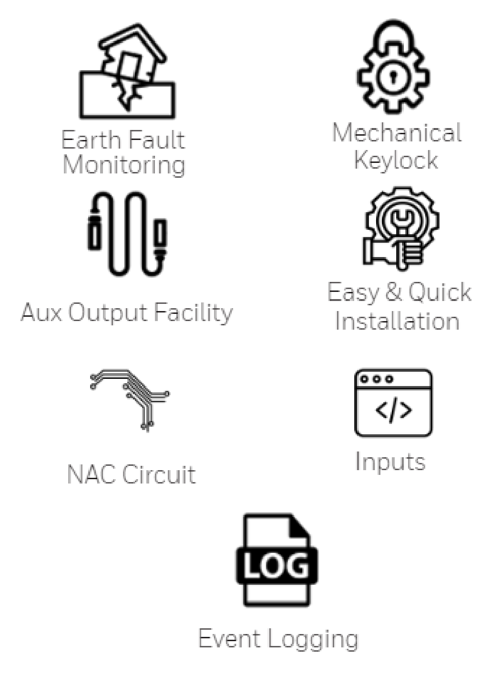
KEY FEATURES
MORLEY
LITE
SYSTEM
SENSOR

Slide 10
DETECTORS & MODULES
Morley Lite

Slide 11
Morley Lite
COMPATIBLE DEVICES

Slide 12
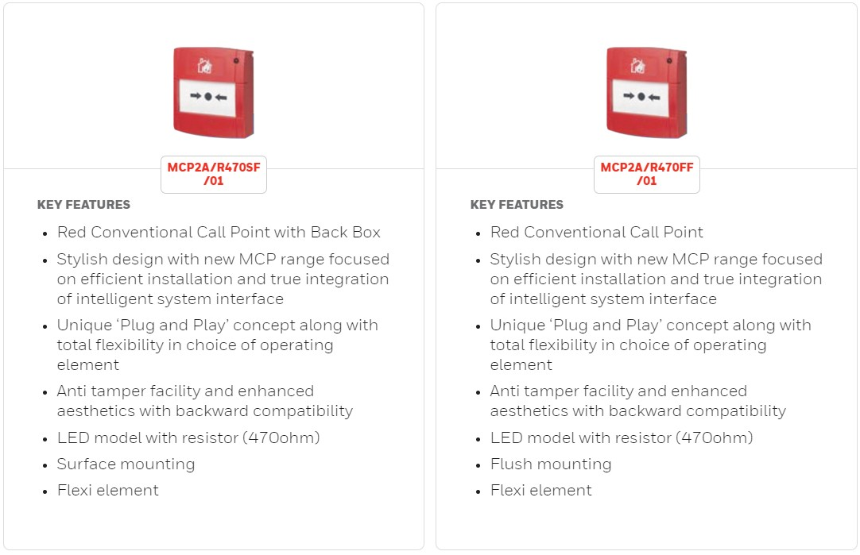
COMPATIBLE DEVICES
Morley Lite

Slide 13
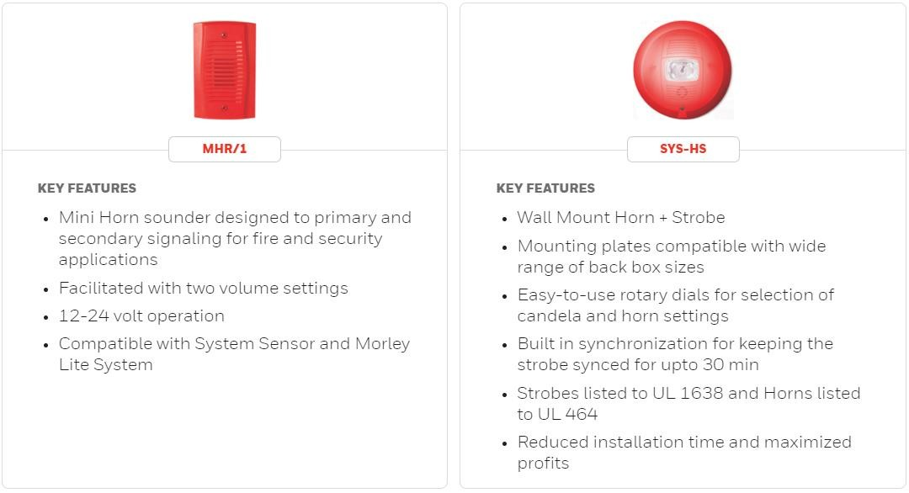
COMPATIBLE DEVICES
Morley Lite

Slide 14
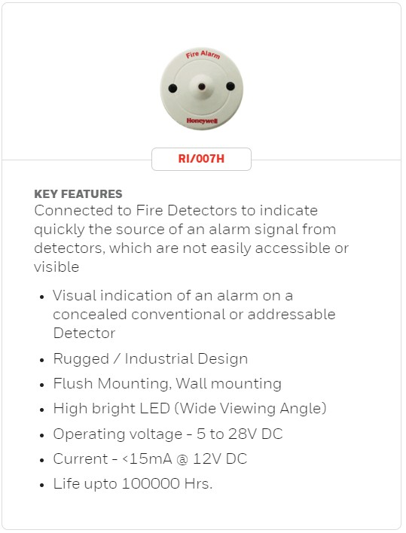
Morley Lite
COMPATIBLE DEVICES

Slide 18
DETECTORS & MODULES
System Sensor

Slide 19
COMPATIBLE DEVICES

Slide 20
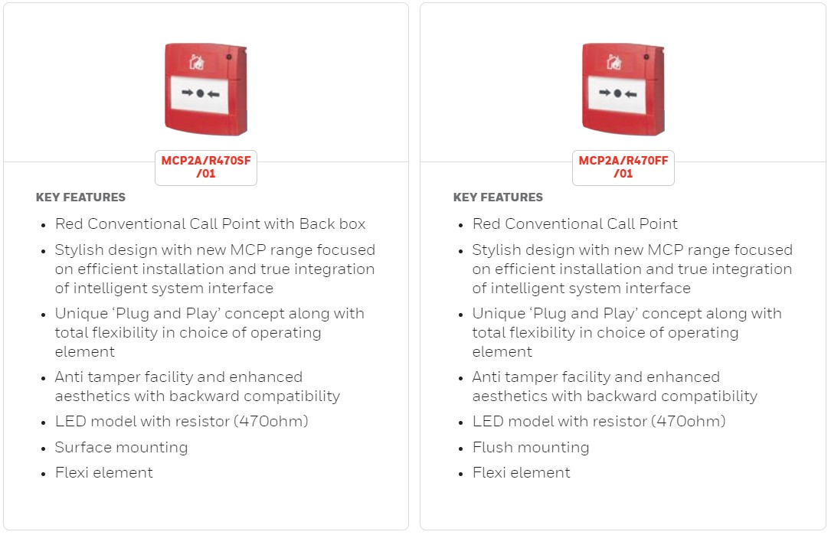
COMPATIBLE DEVICES

Slide 21
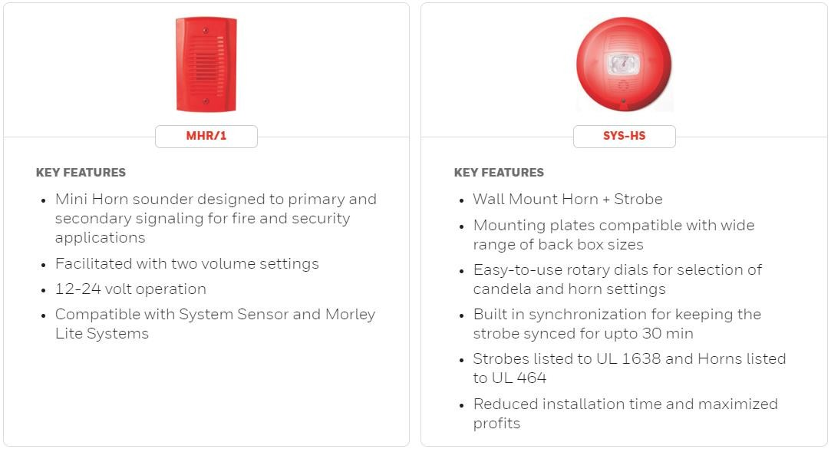
COMPATIBLE DEVICES

Slide 22
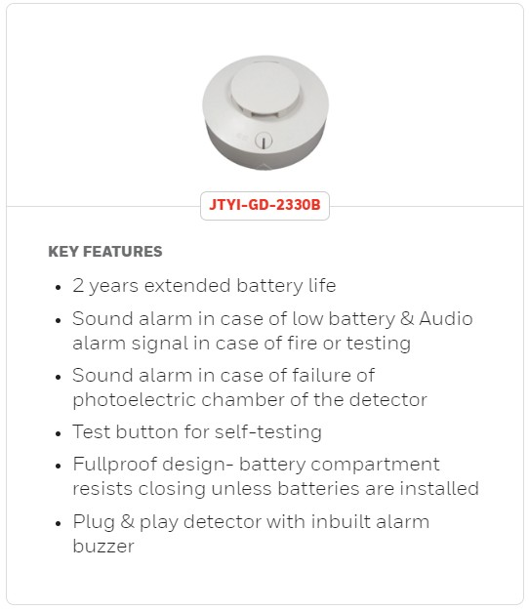
COMPATIBLE DEVICES

Slide 23
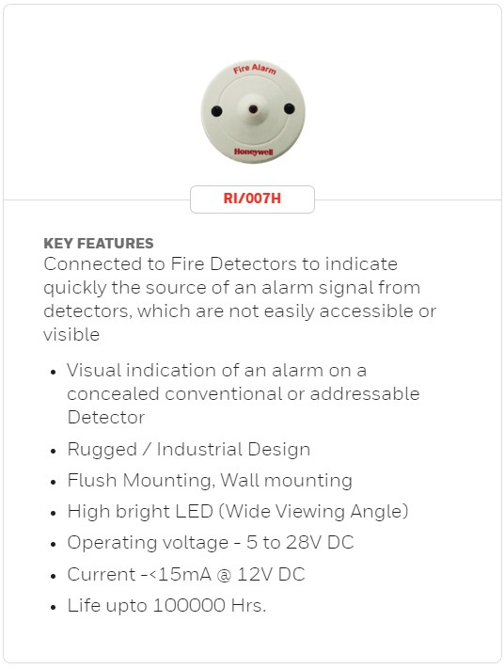
COMPATIBLE DEVICES

Slide 24
WIRELESS SMOKE DETECTOR (WSD)

Slide 25
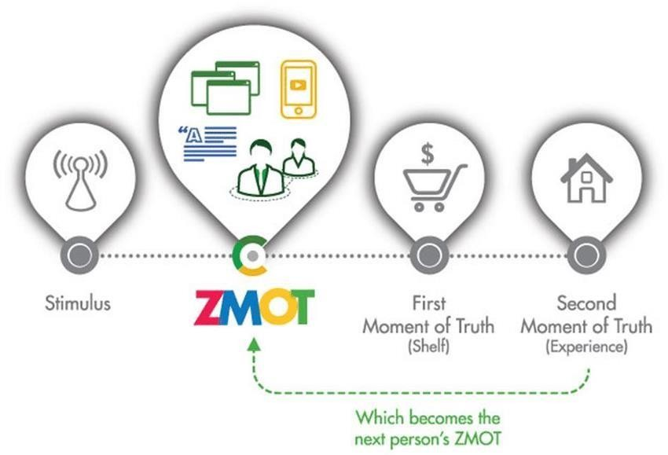
IMPACTWIRELESSSMOKEDETECTOR
A SMART, CONNECTED SMOKE DETECTOR WITH SIMPLE & EASY
OPERATION- CONTROLLED FROM ANWHERE
Connected & Smart
IMPACT WSD folows The 4 pilars of Customer Experience
Proactive
& Watchful
Afordable
& Simple
Affordable Fire Security
Suited Across Business Establishments
Premium Design & UX Focus
Trust Of
Honeywell

Slide 26
IMPACT WIRELESS SMOKE DETECTOR
25
Wireless Smoke Detector, built on Global Standards, for 24x7 proactive fire safety- Alerts on your mobile Device & Visual + Audio Alerts. OPEX Model. Addresses The Fire Safety Needs of SME & Enterprise At An Affordable Price-point.
Key Proposition Pillars
CONNECTED | WATCHFUL | USER-DRIVEN | PROACTIVE
Features
Detects Smoke- Incipient fire
Battery Operated- 4AA Battery
App controlled- Instant Alerts
Visual & Audio Alarm
Connected Device- Wi-Fi
DIY- Easy to Operate & Install
Photoelectric Technology
App Controlled
Mobile App
Notification
Easy to Install & Operate
Real-time
Alerts
Alerts
Audio & Visual Alerts
Smoke Detection Alert
LED on Device
Audio Alarm- Buzzer
Incoming Call on Phone in case of Smoke
Detection
Works on Wi- Fi
Event Logs & Device Status
Incoming Call Alert on Mobile
Trust of The World Leader in Fire Safety

Slide 27
Thanks!

